Slide 1
Developing paragraphs
ENGL 1301
Instructor: Akshata Balghare
4 march, 2019

Slide 2

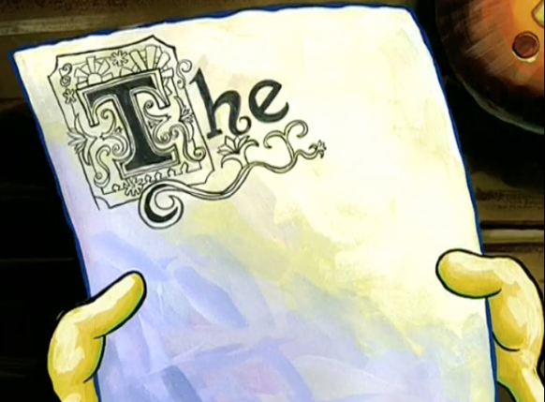
Introductory paragraph
What do we write in an introduction?
(Think about the introductory paragraph you developed for
Assignment II)
What is the motive of an introduction?
How can we make introductions interesting?
(Think about the articles we read in Unit I: The world book by David Mann)

Slide 3
Introduction for rhetorical analysis assignment
You already have a summary!
How might you edit this summary to convert it into an introduction?

Slide 4

Creating strong paragraphs Look at the following para: (Handbook pp. 95)
"I never knew anyone who’d grown up in Jackson without being afraid of Mrs. Calloway, our librarian.
She ran the Library absolutely by herself, from the desk where she sat with her back to the books and facing the stairs, her dragon eye on the front door, where who knew what kind of person might come in from the public?
SILENCE in big black letters was on signs tacked up everywhere.
She herself spoke in her normally commanding voice; every word could be heard all over the Library above a steady seething sound coming from her electric fan; it was the only fan in the Library and stood on her desk, turned directly onto her streaming face."

Slide 5
(Handbook Pg. 95)
Three qualities essential to most academic paragraphs:
unity, development, and coherence.
It focuses on one main idea (unity);
its main idea is supported with specifics (development); and
its parts are clearly related (coherence)"

Slide 6
Topic sentences (Handbook pp. 96)
A topic sentence often appears at the beginning of a paragraph, but it can come at the end — or it may be implied rather than stated directly.
But what is a topic sentence?

Slide 7
Topic sentence
A sentence that expresses the main idea of the paragraph in which it occurs.
If you want readers to see your point immediately, open with the topic sentence. This strategy can be particularly useful in argumentative writing.

Slide 8
Coherence in paragraphs
Use signposting
Many people simply throw facts together in body paragraphs, without properly applying them to the topic or signaling to the reader the connections between them.

Slide 9

Simply look at the following para
Incorporation offers several advantages to businesses and their owners such as easy transfer of ownership. The business is able to maintain a continuous existence even when the original owners are no longer involved (Brown, 1999). The stockholders of a corporation are not held responsible for the business's debts (Henry, 2009). If the XYZ Corporation defaults on a $1 million loan, its investors will not be held responsible for paying that liability. Incorporation also enables a business to obtain professional managers with centralised authority and responsibility allowing the business to run more efficiently (Schwartz, 2010). Incorporation gives a business certain legal rights. It can enter into contracts, own property, and borrow money (Brown, 1999).

Slide 10
Now how do you feel about this para?
Incorporation offers several advantages to businesses and their owners. For one thing, ownership is easy to transfer. The business is able to maintain a continuous existence even when the original owners are no longer involved (Brown, 1999). In addition, the stockholders of a corporation are not held responsible for the business's debts (Henry, 2009). If the XYZ Corporation defaults on a $1 million loan, for instance, its investors will not be held responsible for paying that liability. Also, Incorporation enables a business to obtain professional managers with centralised authority and responsibility; therefore, the business can be run more efficiently (Schwartz, 2010). Finally, incorporation gives a business certain legal rights. For example, it can enter into contracts, own property, and borrow money (Brown, 1999).

Slide 11

Signposts tell the readers how each group of ideas follow from the ones before, and whether information is:
an additional point
in contrast to what has been said
an example

Slide 12
Patterns of organizing content
Dividing, classifying information when necessary
Comparison contrast
Chronology in information
Problem-solution

Slide 13
Using transitions
Additionally/ In addition
Further/Furthermore
Moreover
Conversely
However
In contrast
One the one hand/On the other hand
In comparison
In the same way
By comparison
In a similar fashion
In a similar manner

Slide 14
For your rhetorical analysis, look at the organization of the articles/videos
Think about how the author organize text in the article/video

Slide 15
For Wednesday
We will discuss
thesis statements
Paragraphs again
Conclusion

Slide 16
Class activity
Peer review on rhetorical analysis
Working on introduction paragraphs

